Slide 1
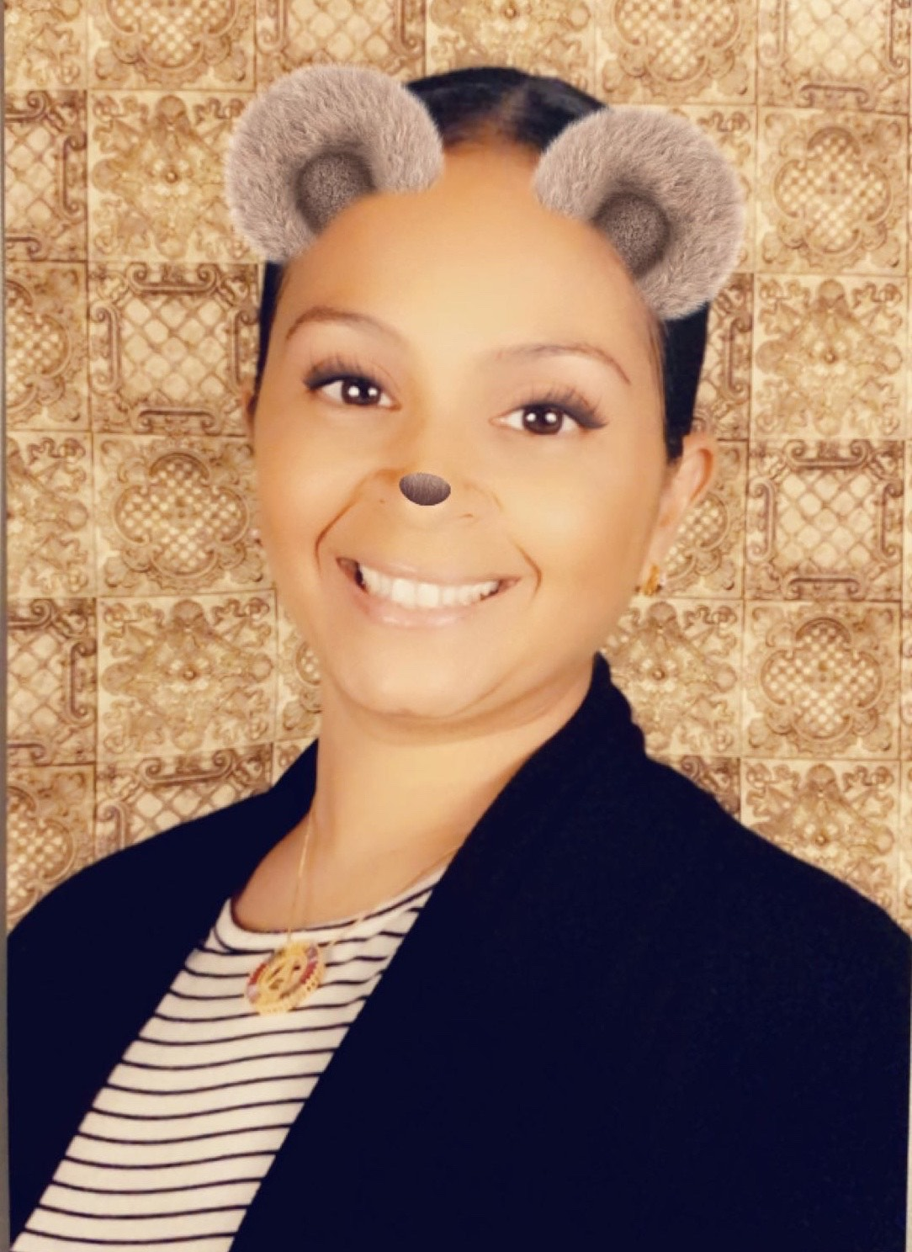
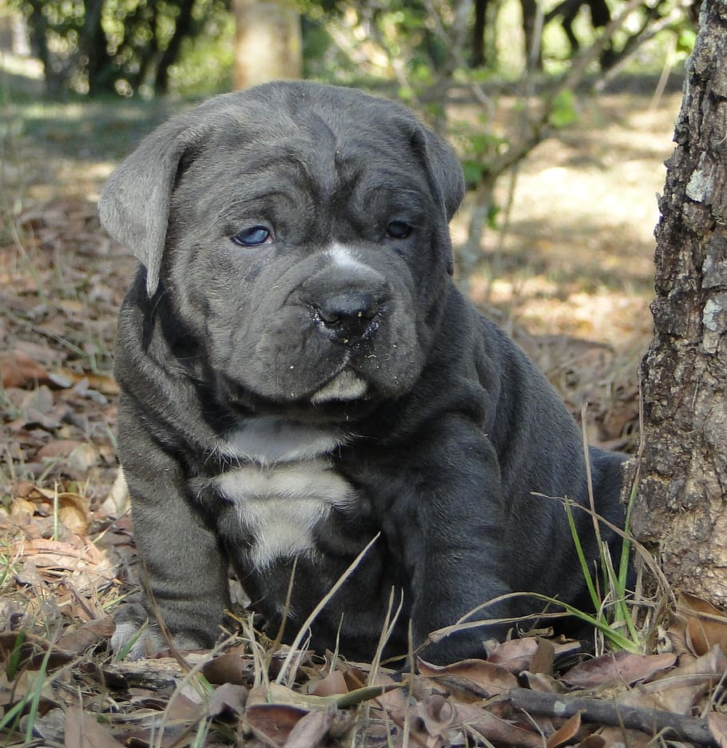
Add Photo
Hello, Class 16! I am so excited to be your teacher for the 2024-2025 school year. Our year is going to be filled with lots of excitement and learning. I am so happy I get to be a part of your education. I look forward to having a magical school year.
Mrs.
Jackson
Here are a few of my favorite things:
Animal: I love dogs
Book: The House on Mango Street
Hobby: Coloring & Drawing
Color: Blue
Food: Mexican Food
Drink: Iced Coffee
Please feel free to reach out if you have any questions:
Email: Ajackson@yonkerspublicschools.org
Phone: 914-341-2171

